Slide 1
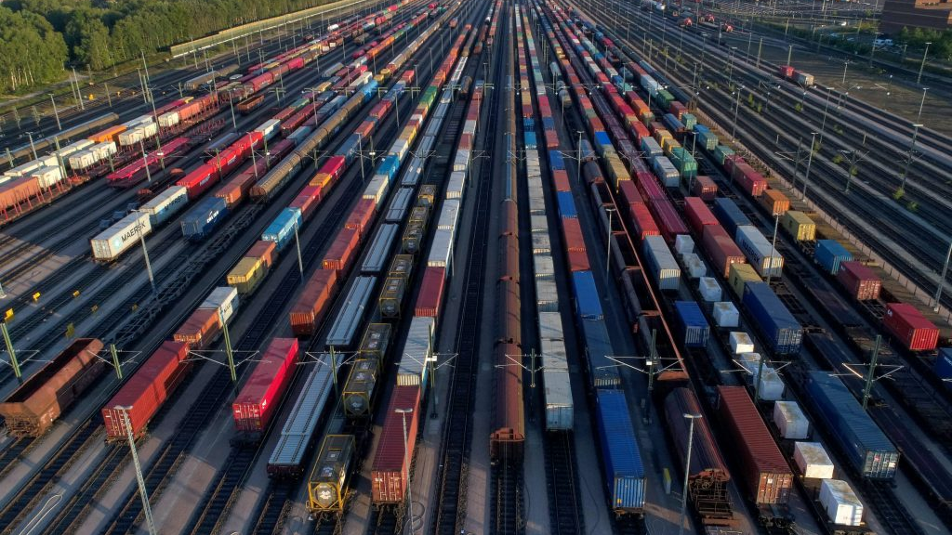


Train Path Request Fulfilment Prediction midterm meeting
Advanced Data Science for TTE (CIEM6302)
Quinten Schimmel - 5266408
Reno Heng Gong - 6215246
Rosanne de Jong - 5374588
Wendy Chi - 5340942

Slide 2

Contents
Problem Description & Research question
Data cleaning
Data exploration
Logistic regression

Slide 3
Problem description
Train path request process
  ProRail plans
  Operator plans and ProRail responds
Insight planning process
Positive response expectation
Submission shows probability of fulfillment

Slide 4
How can a data-driven model be used to predict the likelihood that a train path request by an operator will be granted by ProRail based on historical data?

Slide 5
Sub-questions
Time tolerance
Match between request and response
Destinations and stabling
Request time
Timing request and operation

Slide 6
Data cleaning
Rows
Use only reactions: AANGEBODEN and GEEN_AANBIEDING_MOGELIJK
Use only Ad_HOC requests
Use only NEW request
Remove duplicate requests
Original set: 3.200.000 requests
After removal: 72.000 requests

Slide 7
Data cleaning
Columns
Keep required columns based on research questions
Create additional columns:
  Time_Tolerance
  Stabling_needed
  Number_of_stops_requested
Numerical data
Required for Machine Learning

Slide 8
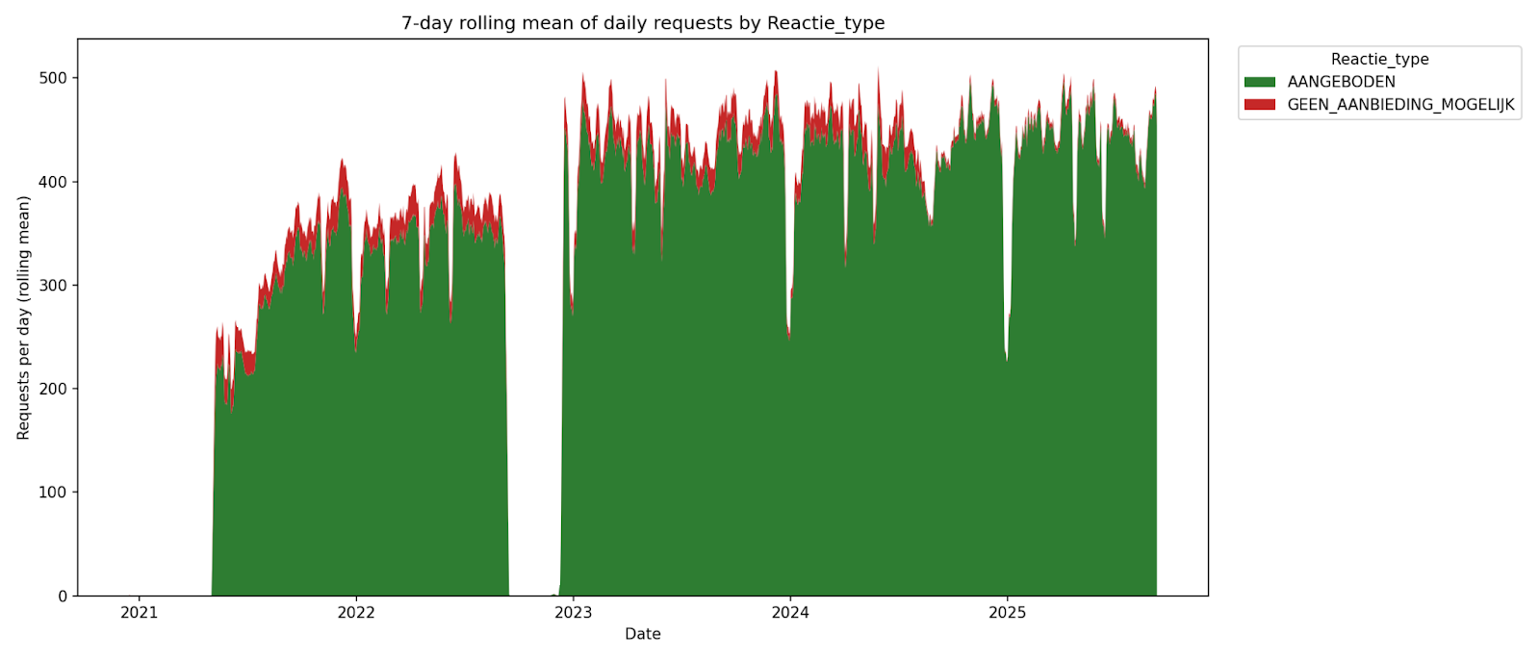

Slide 9
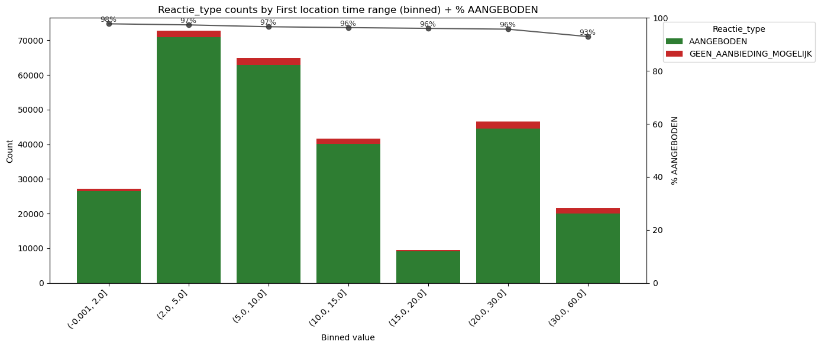
Data exploration
How does time tolerance (earliest and latest preferred departure) affect the probability?

Slide 10
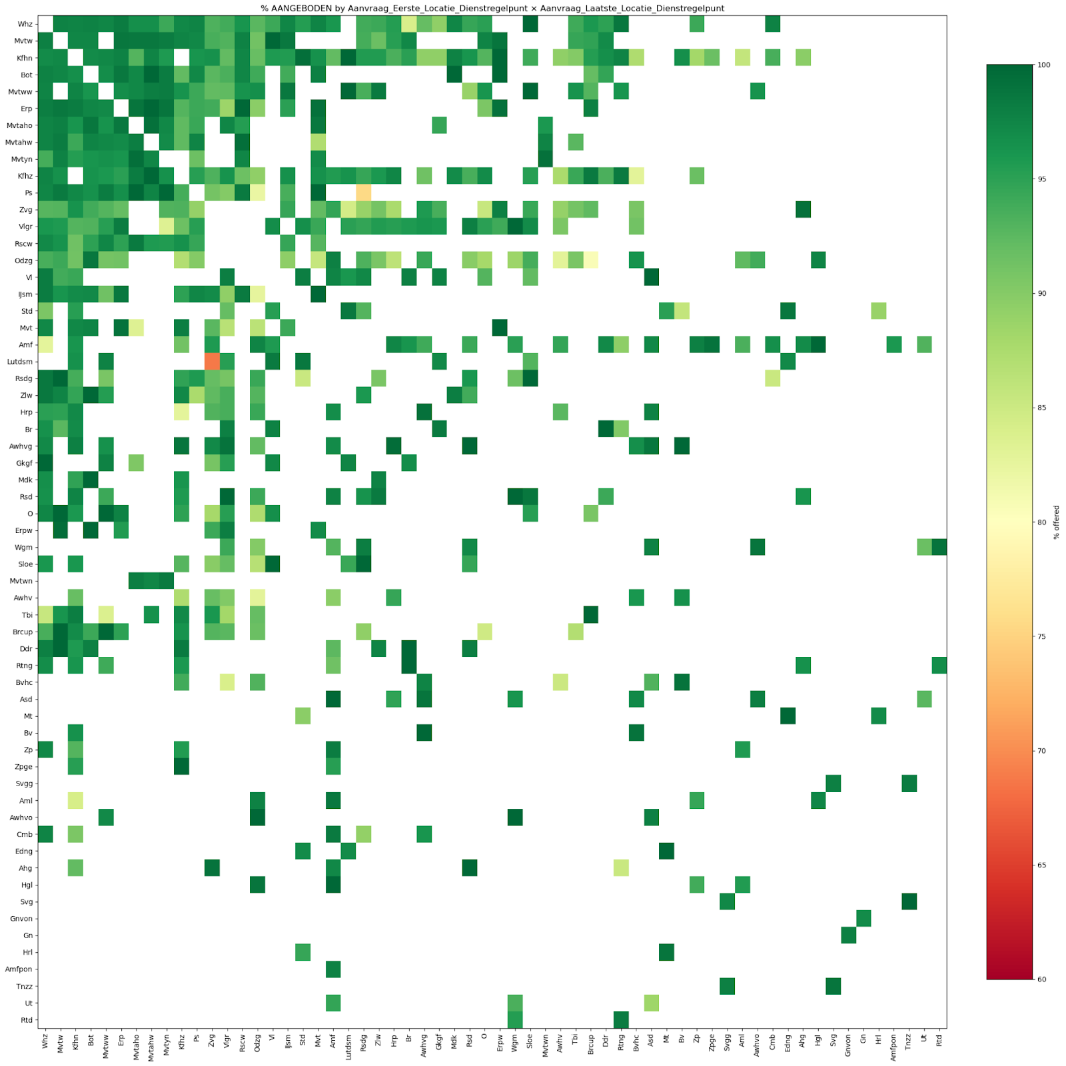
Data exploration
Do route structure and stabling/service needs influence outcomes?
Absolute counts Rotterdam
Relative counts: Surprising
Lutterade DSM - Zevenaar grens

Slide 11
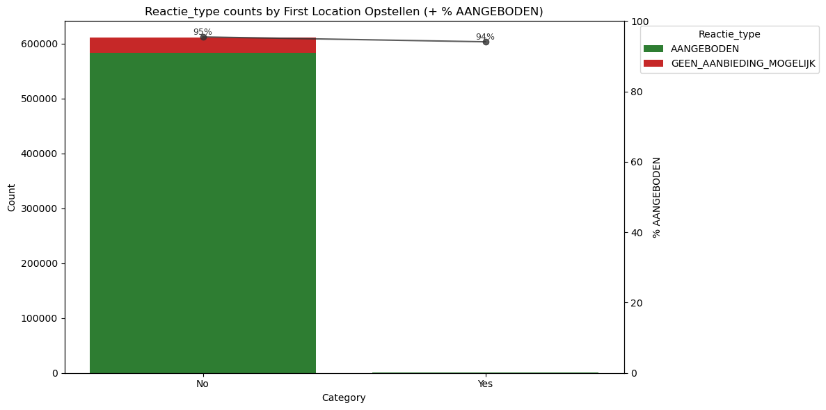
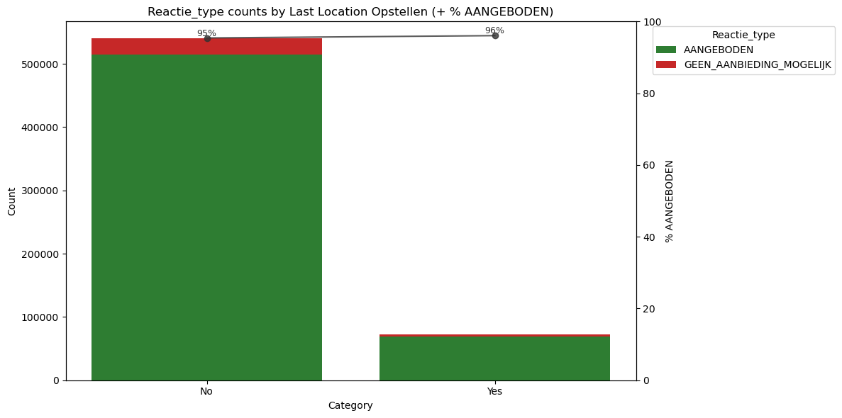
Data exploration
Do route structure and stabling/service needs influence outcomes?
Operators request stabling for last location rather than first location
No significant difference

Slide 12
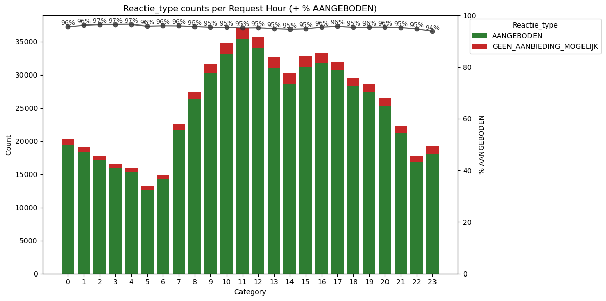
Data exploration
Are operator, planning phase, and request timing (hour/day/week) predictive?
Hour: Absolute numbers increase after 6 in the morning and decrease after 16 pm.

Slide 13
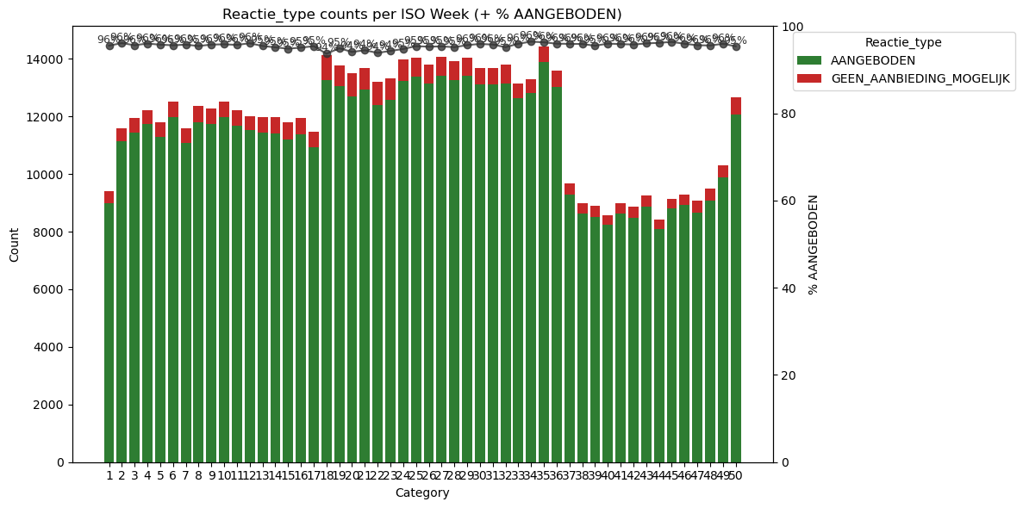
Data exploration
Are operator, planning phase, and request timing (hour/day/week) predictive?
Week: Significant increase in april, few requests during Christmas break

Slide 14
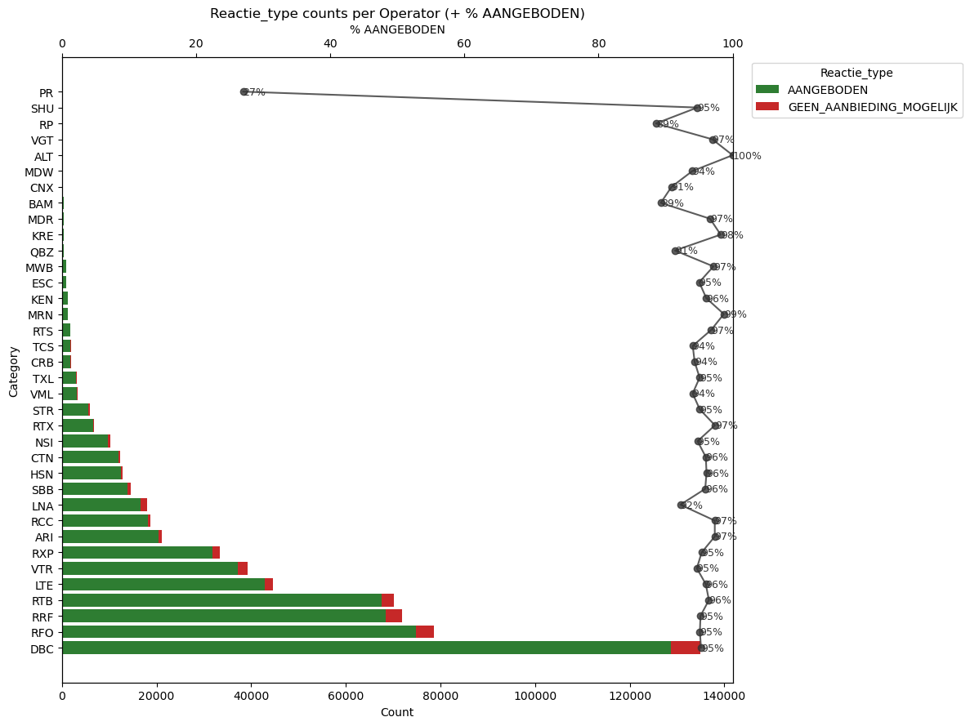
Data exploration
Are operator, planning phase, and request timing (hour/day/week) predictive?

Slide 15
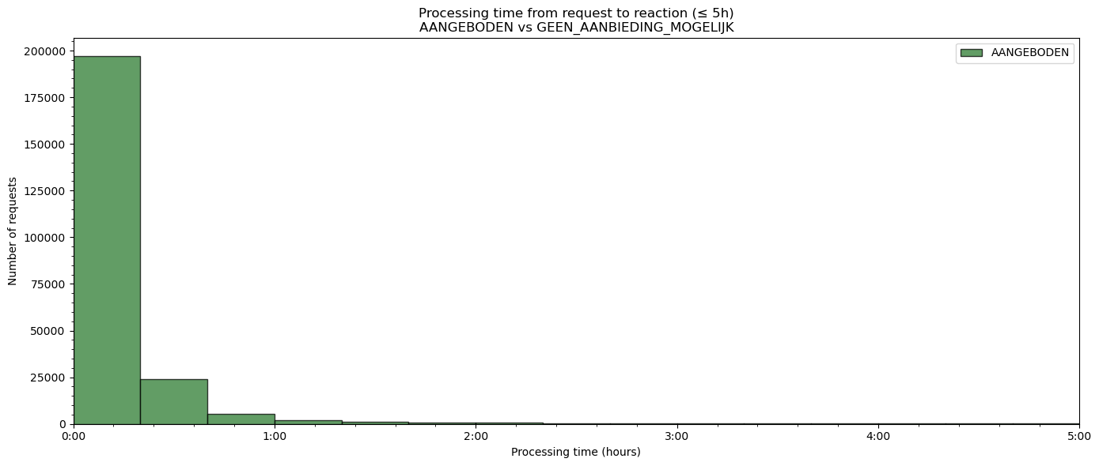
Data exploration
Difference between operation moment (hour) and request timing

Slide 16
Possible solutions
Why machine learning?
To predict unseen scenarios
To give more accurate answers rather than an overall probability
Why logistic regression?
Classification model
Output is a possibility

Slide 17
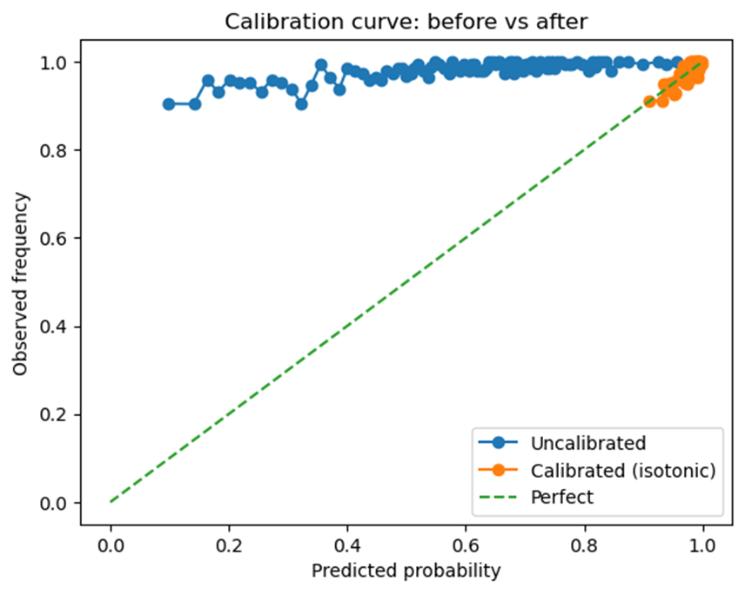
First outcomes
Prediction example
Total: 72 734
Approved: 71 350
Rejected: 1 384
Approval rate: 0.98

Slide 18
Future steps
How good is the match between the request of the operator and the response of Prorail?
Look at more features that might be relevant - weight, speed, length and others
Try other models: Random forests, Deep learning

Slide 19
Process
How did we work?
What went wrong?
  Communication
  Incomplete dataset

Slide 20
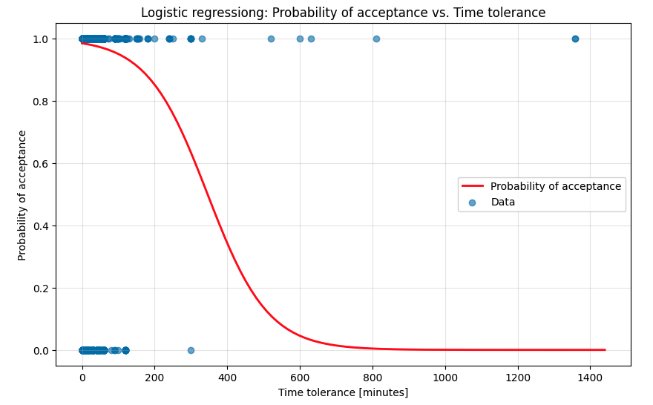
Questions:
Why does a larger time tolerance make it less likely that the system will accept the request?

Slide 21
Questions
High acceptance rate → how to focus on rejected requests?
New type in dataset: vigerende orders

Slide 22
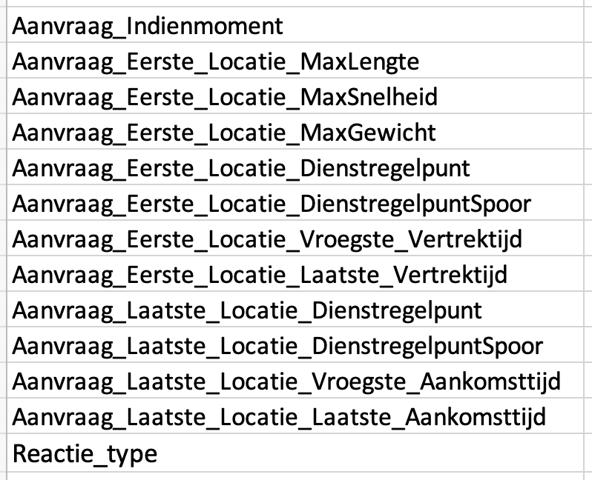
Appendix
Used columns

